Slide 1
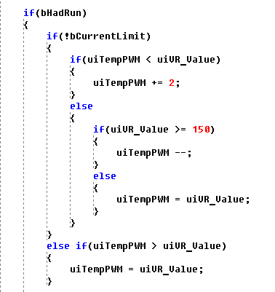
Speed up step to full speed stepping

Slide 2
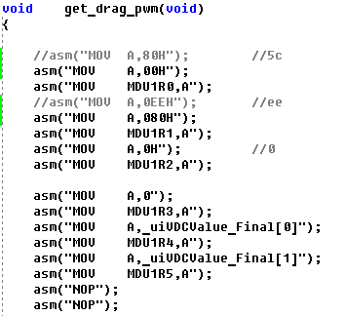
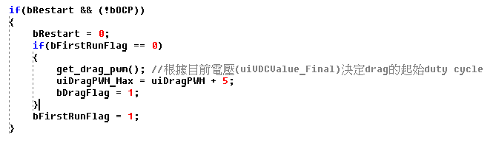
計算不同輸入電壓下的start up duty
Start up PWM at drag mode
[MDU1R1,MDU1R0]
----------------------------
uiVDCValue_Final
VDC越大duty越小
Start up max PWM at drag mode

Slide 3
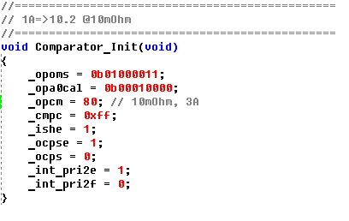
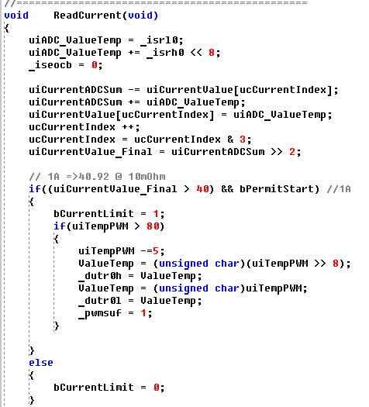
OCP setting
Current limit setting
Current limit decrease step setting

Slide 4
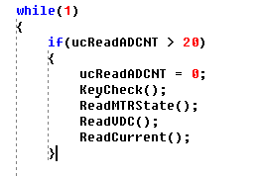
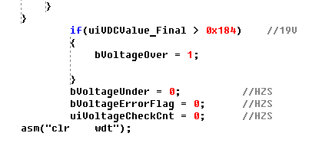

ADC 約每20ms讀一次
ReadVDC()
OVP設定, 1V → 20.46

Slide 5

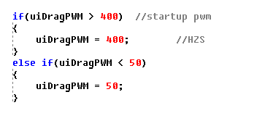
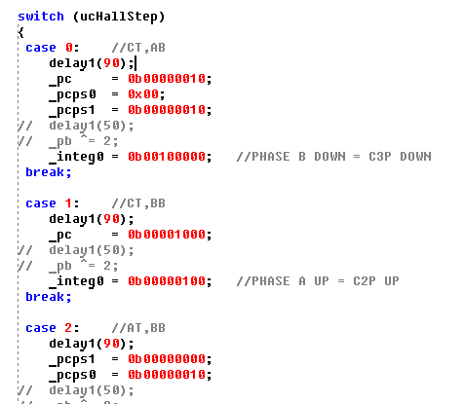
調整起轉速度
最大的dragPWM
Hall delay for communtation

